Slide 1
Pipeline & Parallel Processing

Slide 2
What is Pipelining?
Pipelining is a technique of breaking a sequential process into small fragments or sub-operations. The execution of each of these sub-procedure takes place in a certain dedicated segment that functions together with all other segments.

Slide 3
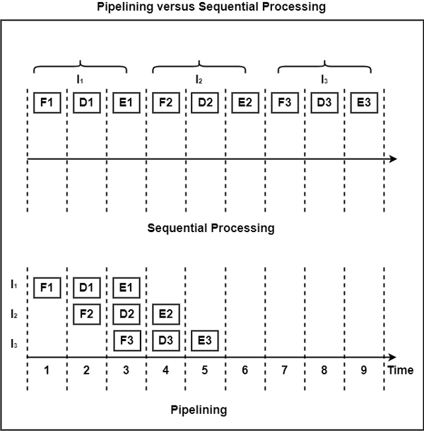

Slide 4
Parallel Processing
Parallel processing is a term used to denote a large class of techniques that are used to provide simultaneous data-processing tasks for the purpose of increasing the computational speed of a computer system.
Instead of processing each instruction sequentially as in a conventional computer, a parallel processing system is able to perform concurrent data processing to achieve faster execution time. For example, while an instruction is being executed in the ALU, the next instruction can be read from memory.
The system may have two or more ALUs and be able to execute two or more instructions at the same time. Furthermore, the system may have two or more processors operating concurrently.
The purpose of parallel processing is to speed up the computer processing capability and increase its throughput, that is, the amount of processing that can be accomplished during a given interval of time. The amount of hardware increases with parallel processing and with it, the cost of the system increases. However, technological developments have reduced hardware costs to the point where parallel processing techniques a.re economically feasible.

Slide 5
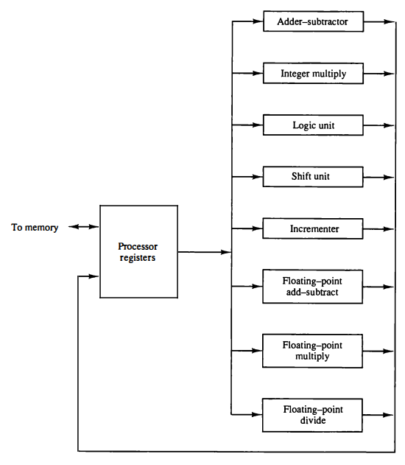
Multiple functional units
Figure shows one possible way of separating the execution unit into eight functional units operating in parallel.
The operands in the registers are applied to one of the units depending on the operation specified by the instruction associated with the operands.
The operation performed in each functional unit is indicated in each block of the diagram.
The adder and integer multiplier perform the arithmetic operations with integer numbers.
The floating-point operations are separated into three circuits operating in parallel.
The logic, shift, and increment operations can be performed concurrently on different data.
All units are independent of each other, so one number can be shifted while another number is being incremented. A multifunctional organization is usually associated with a complex control unit to coordinate all the activities among the various components.
Processor with multiple functional units

Slide 6
Flynn’s Classification
There are a variety of ways that parallel processing can be classified. It can be considered from the internal organization of the processors, from the interconnection structure between processors, or from the flow of information through the system.
One classification introduced by M. J. Flynn considers the organization of a computer system by the number of instructions and data items that are manipulated simultaneously.
The normal operation of a computer is to fetch instructions from memory and execute them in the processor.
The sequence of instructions read from memory constitutes an instruction stream.
The operations performed on the data in the processor constitutes a data stream . Parallel processing may occur in the instruction stream, in the data stream, or in both.
Flynn's classification divides computers into four major groups as follows:
Single instruction stream, single data stream (SISD).
Single instruction stream, multiple data stream (SIMD).
Multiple instruction stream, single data stream (MISD).
Multiple instruction stream, multiple data stream (MIMD)

Slide 7
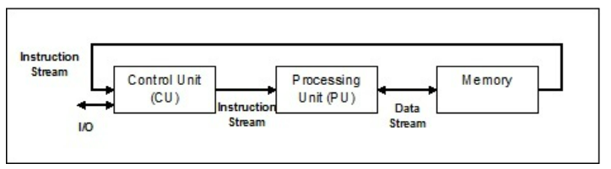
SISD
SISD represents the organization of a single computer containing a control unit, a processor unit, and a memory unit. Instructions are executed sequentially and the system may or may not have internal parallel processing capabilities. Parallel processing in this case may be achieved by means of multiple functional units or by pipeline processing.

Slide 8
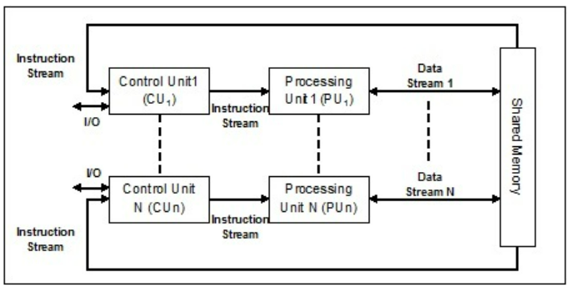
SIMD
SIMD represents an organization that includes many processing units under the supervision of a common control unit. All processors receive the same instruction from the control unit but operate on different items of data. The shared memory unit must contain multiple modules so that it can communicate with all the processors simultaneously. Following is the architecture of SIMD −

Slide 9
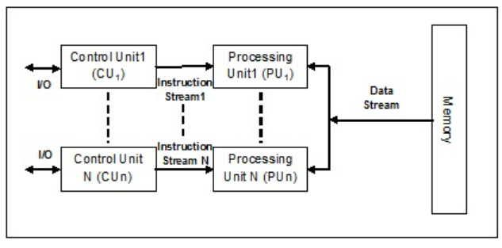
MISD
Systems with MISD stream have number of processing units performing different operations by executing different instructions on the same data set. It is only of theoretical interest since no practical system has been constructed with this organization. Following is the architecture of MISD −

Slide 10
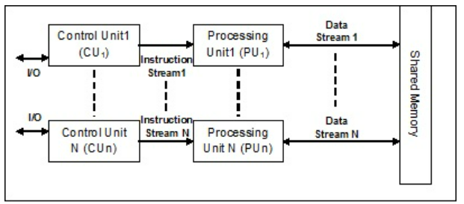
MIMD
In the system using MIMD architecture, MIMD organization refers to a computer system capable of processing several programs at the same time. Most multiprocessor and multicomputer systems can be classified in this category. Following is the architecture of MIMD −

Slide 11
Pipelining is a technique of decomposing a sequential process into sub-opera­tions, with each sub-process being executed in a special dedicated segment that operates concurrently with all other segments.
A pipeline can be visualized as a collection of processing segments through which binary information flows. Each segment performs partial processing dictated by the way the task is partitioned.
The result obtained from the computation in each segment is transferred to the next segment in the pipeline.
The final result is obtained after the data have passed through all segments.
The name "pipeline" implies a flow of information analogous to an industrial assembly line. It is characteristic of pipelines that several computations can be in progress in distinct segments at the same time.
The overlapping of computation is made possible by associ­ating a register with each segment in the pipeline.
The registers provide isolation between each segment so that each can operate on distinct data simultaneously.

Slide 12
The pipeline organization will be demonstrated by means of a simple example. Suppose that we want to perform the combined multiply and add operations with a stream of numbers.
A_{i} •B_{i} + C_{i}
for i = 1, 2, 3, . .. , 7
Each sub operation is to be implemented in a segment within a pipeline. Each segment has one or two registers and a combinational circuit as shown in Fig. 9-2. R 1 through RS are registers that receive new data with every clock pulse. The multiplier and adder are combinational circuits. The suboperations per­ formed in each segment of the pipeline are as follows:
R1<-- A,, R2<-- B, Input A, and B,
R3 <-- R1•R2, R4<-- C, Multiply and input C,
R5<-- R3 + R4 Add C; to product

Slide 13
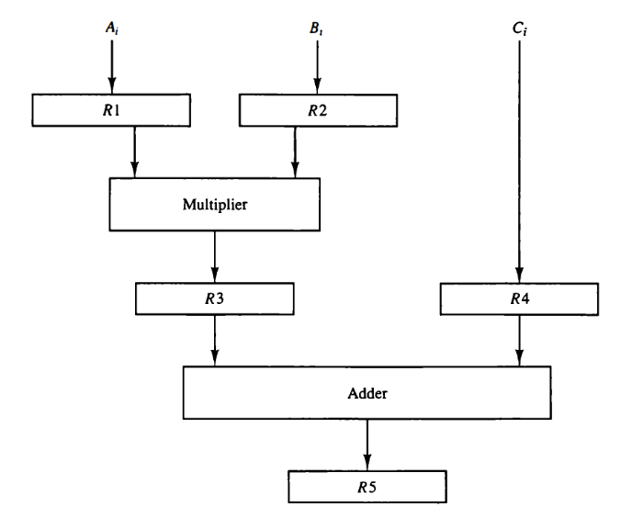
Figure 9.2 Example of pipeline processing.

Slide 14
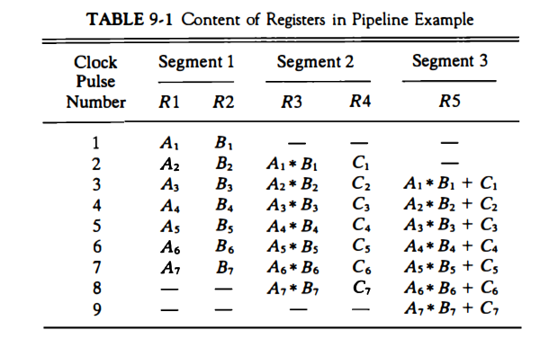

Slide 15
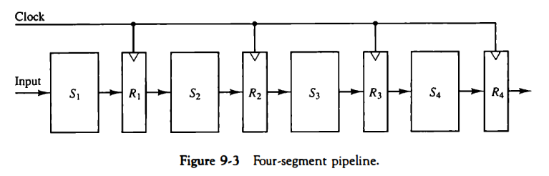
General Considerations
Any operation that can be decomposed into a sequence of sub-operations of about the same complexity can be implemented by a pipeline processor. The technique is efficient for those applications that need to repeat the same task many times with different sets of data.
The general structure of a four-segment pipeline is illustrated in Fig. 9-3.
The operands pass through all four segments in a fixed sequence. Each segment consists of a combinational circuit S; that performs a sub-operation over the data stream flowing through the pipe.
The segments are separated by registers R; that hold the intermediate results between the stages. Information flows between adjacent stages under the control of a common clock applied to all the registers simultaneously.
Task is defined as the total operation performed going through all the segments in the pipeline.

Slide 16
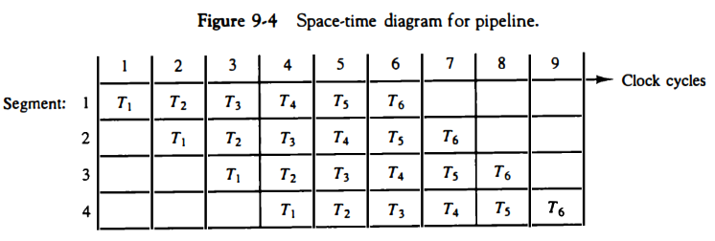
The behavior of a pipeline can be illustrated with a space-time diagram. This is a diagram that shows the segment utilization as a function of time.
The space-time diagram of a four-segment pipeline is demonstrated in Fig. 9-4. The horizontal axis displays the time in clock cycles and the vertical axis gives the segment number.
The diagram shows six tasks T1 through T6 executed in four segments.

Slide 17
Initially, task T1 is handled by segment 1. After the first clock, segment 2 is busy with T1, while segment 1 is busy with task T2.
Continuing in this manner, the first task T1 is completed after the fourth clock cycle. From then on, the pipe completes a task every clock cycle. No matter how many segments there are in the system, once the pipeline is full, it takes only one clock period to obtain an output.
Now consider the case where a k-segment pipeline with a clock cycle time t, is used to execute n tasks. The first task T1 requires a time equal to kt, to complete its operation since there are k segments in the pipe. The remaining n - 1 tasks emerge from the pipe at the rate of one task per clock cycle and they will be completed after a time equal to (n - 1)t,. Therefore, to complete n tasks using a k-segment pipeline requires k + (n - 1) clock cycles. For exa­mple, the diagram of Fig. 9-4 shows four segments and six tasks. The time required to complete all the operations is 4 + (6 - 1) = 9 clock cycles, as indicated in the diagram.
Speed Up Ratio = (n*T_{n})/(n+k-1)*T_{p}

Slide 18

Arithmetic Pipeline
Pipeline arithmetic units are usually found in very high speed computers. They are used to implement floating-point operations, multiplication of fixed-point numbers, and similar computations encountered in scientific problems.
A pipeline multiplier is essentially an array multiplier with special adders designed to minimize the carry propagation time through the partial products.
Floating-point operations are easily decomposed into sub-operations. An example of a pipeline unit for floating-point addition and subtraction is given below. The inputs to the floating-point adder pipeline are two normalized floating-point binary numbers.
A and B are two fractions that represent the mantissas and a and b are the exponents.
The floating-point addition and subtraction can be performed in four segments, as shown in Fig. 9-6. The registers labeled R are placed between the segments to store intermediate results. The sub-operations that are per­ formed in the four segments are
1. Compare the exponents.
2. Align the mantissas.
3. Add or subtract the mantissas.
4. Normalize the result.

Slide 19
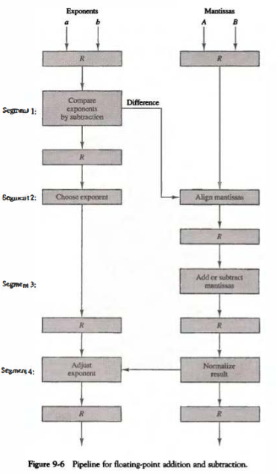

Slide 20
This follows the procedure outlined in the flowchart of Fig. 10-15 but with some variations that are used to reduce the execution time of the sub-operations.
The exponents are compared by subtracting them to determine their difference.
The larger exponent is chosen as the exponent of the result.
The exponent difference determines how many times the mantissa associated with the smaller exponent must be shifted to the right.
This produces an alignment of the two mantissas.
It should be noted that the shift must be designed as a combinational circuit to reduce the shift time.
The two mantissas are added or subtracted in segment 3.
The result is normalized in segment 4.
When an overflow occurs, the mantissa of the sum or difference is shifted right and the exponent incremented by one.
If an underflow occurs, the number of leading zeros in the mantissa determines the number of left shifts in the mantissa and the number that must be subtracted from the exponent. ­

Slide 21
